Slide 1
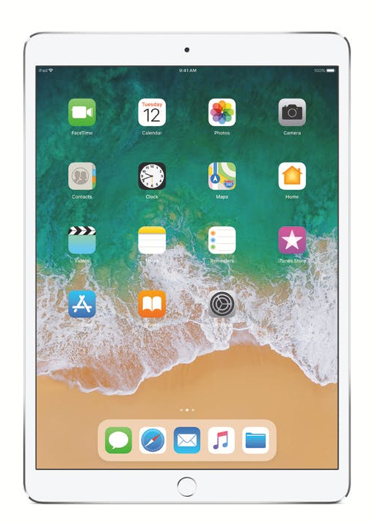
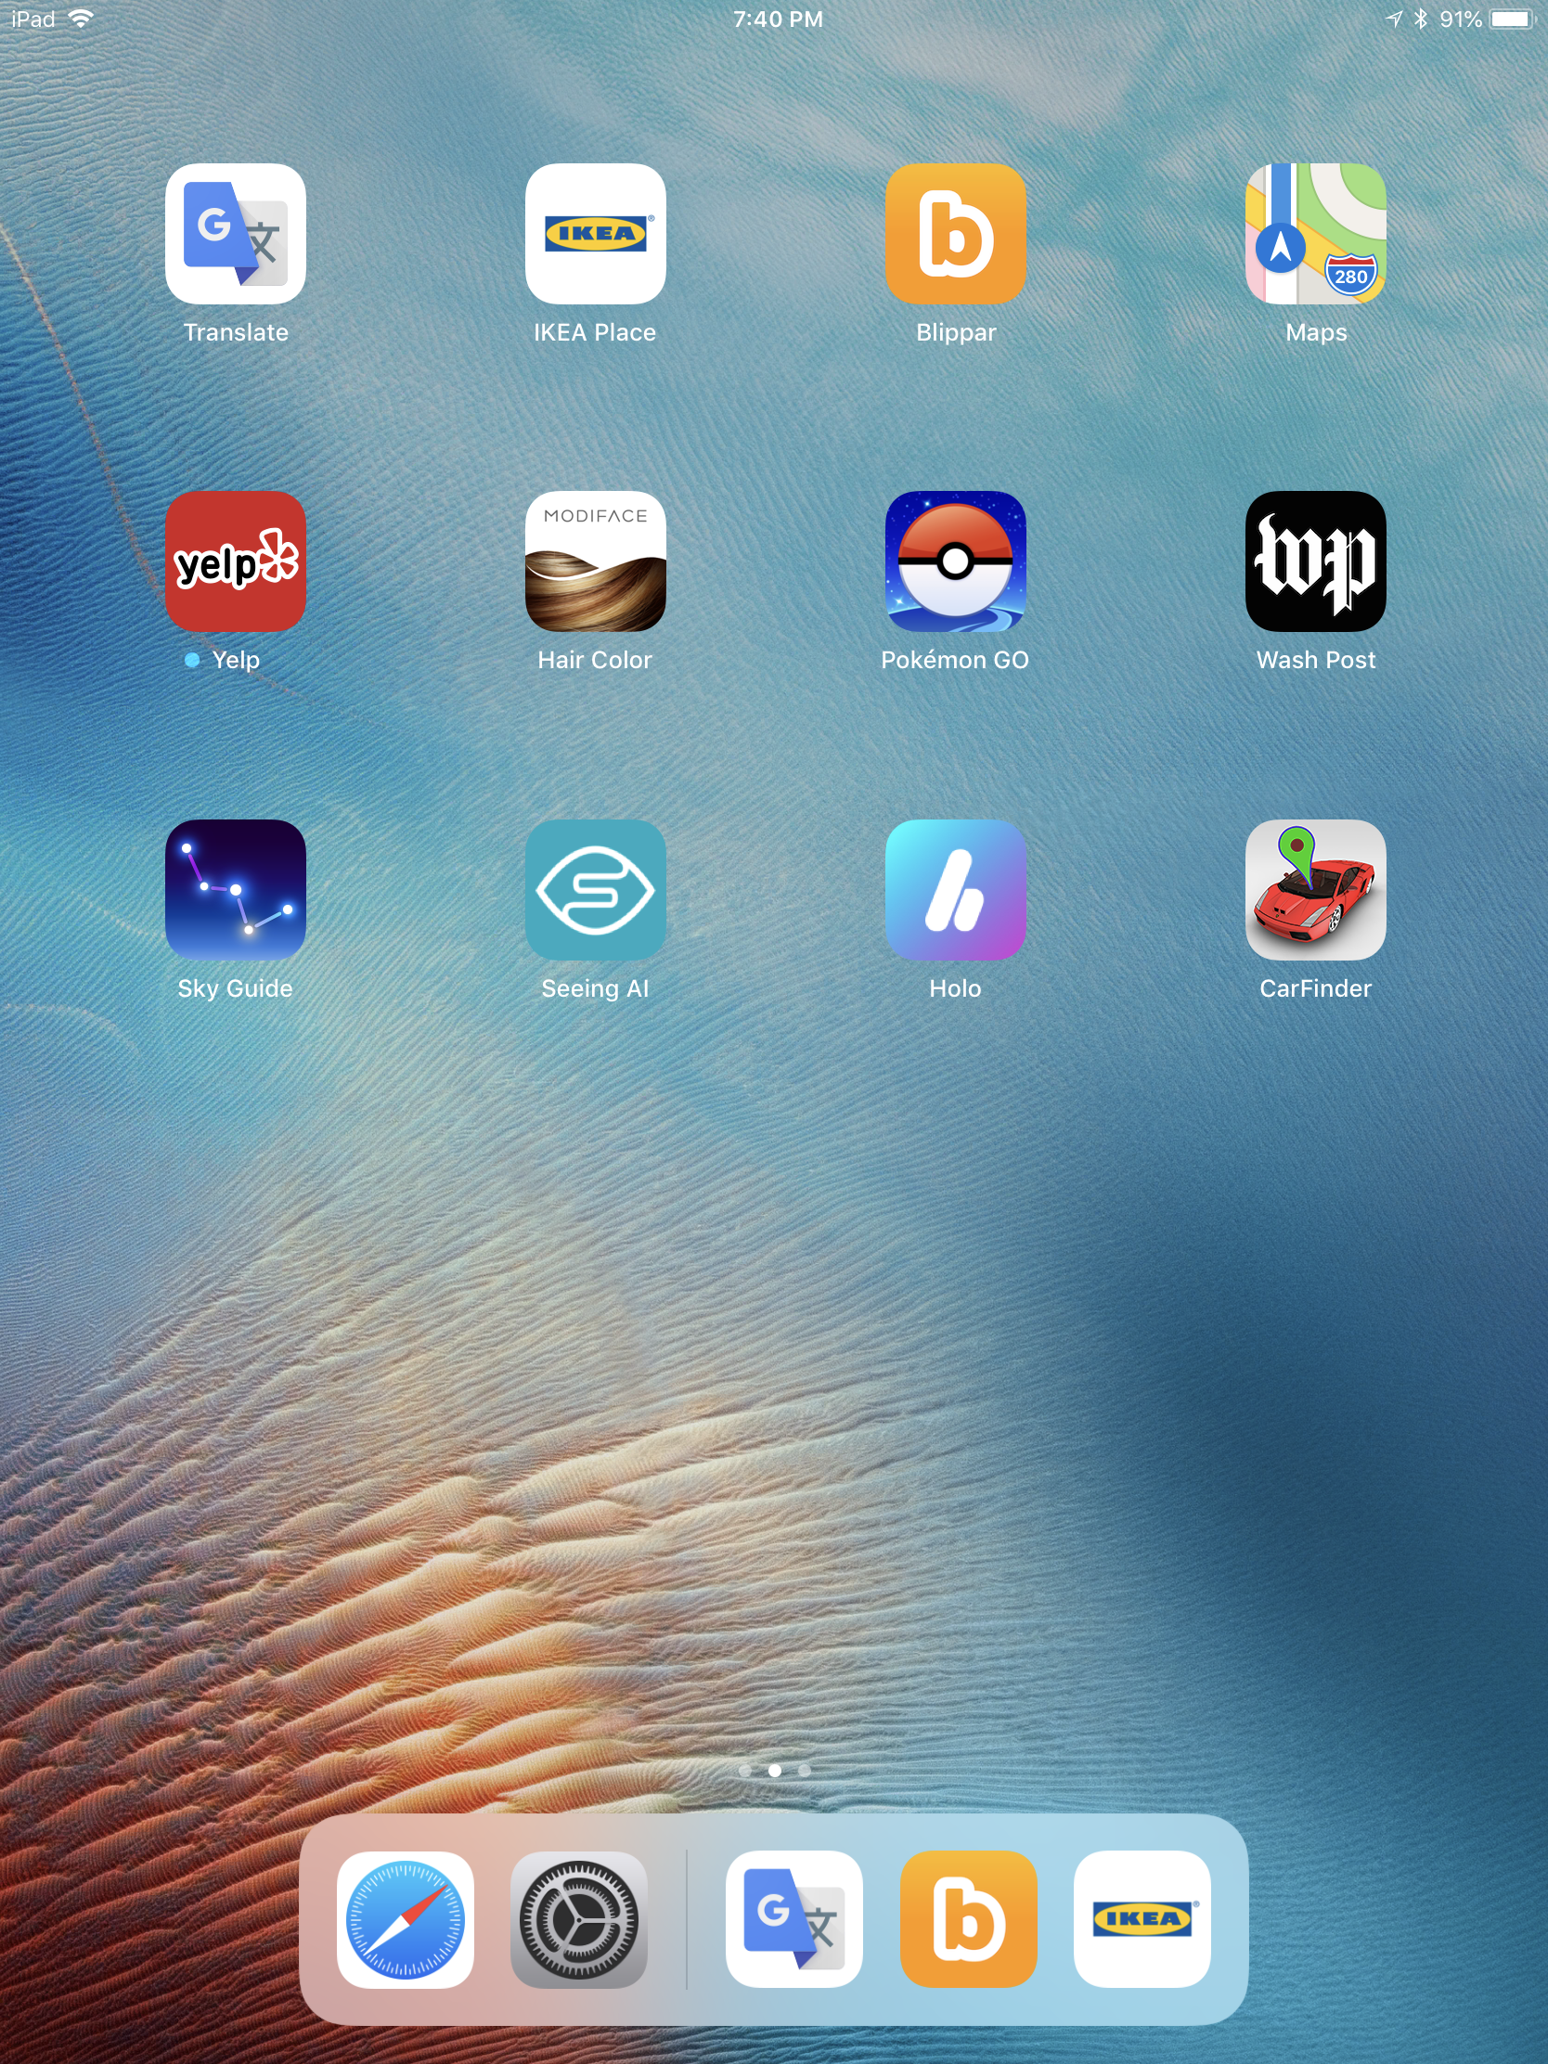
iPad
Camera (on the back)
On / Off Button (top)
Volume + / - Buttons (on the side)
AR apps to try
Home – Press to go back to this screen to start a new app
Augmented Reality on iPhones/iPads, and Android Devices
Augmented Reality (AR) apps on phones and tablets work by combining a live view of the real world from the device’s camera with 2D or 3D graphics generated by the app. Moving and pointing the phone or tablet changes the view.
AR-Capable Phones and Tablets
Apple iPhone 6s and later
iPad 5th and 6th generation, all iPad Pro
Samsung Galaxy S7 and later, Galaxy Note8 and later
Google Nexus 5X and later, all Google Pixel
Samsung Galaxy Tab S3 and S4
Important Note: If you start an Augmented Reality experience and don’t see any AR things or see something funny looking, try backing up with the iPad and/or aiming the camera higher and lower.
Notes:
Full Android device list: https://developers.google.com/ar/discover/supported-devices#android_play

Slide 2



Use with Google Translate

Slide 3

Google Translate
Live AR Language Translation
Take a look at the attached card. It has samples of eight signs in French.
Start Google Translate by tapping its icon.
After a second the app will load. Tap the camera button on the left side of the screen to turn on live text translation.
Hold the iPad above the attached card of sample French signs and move it to point the camera at various signs.
Notice the French text on the printed card is being translated to English on the screen.
When you’re finished trying this app, press the iPad’s Home button to return to the home screen of apps.

Slide 4





Use with Blippar

Slide 5
Blippar
AR Object Recognition
Start Blippar by tapping its icon.
Tap and hold the white circle at the bottom of the screen to start visually searching. A larger white rotating circle will appear. Keep holding and try pointing the iPad at the pictures of celebrities on the card above. Center one person’s face in the large white circle and keep holding.
When the person is recognized, their name will show in a blue circle with their photo. Tap on the blue circle to see related information about the person. When you’re finished looking at related information, tap the X at the top of the screen.
To start a new search press and hold the white circle again.
When you’re finished trying this app, press the iPad’s Home button to return to the home screen of apps.

Slide 6


IKEA Place
AR Interior Design
Start IKEA Place by tapping its icon.
Hold the iPad in its wide orientation and point it at an open area of the floor.
A greeting or instructions may appear in the upper left of the screen depending on what previous users have done in the app.
As you use this app you will need to hold the iPad up with one hand and tap and swipe with the other hand, which can be a bit tricky. Ask someone to help you hold the iPad if you find it challenging.
There may also be virtual furniture left in the room from a previous user. You can ignore it, or delete it by tapping it and then tapping the trash can icon on the left edge of the screen.
Tap the Plus button on the righthand edge of the screen. A catalog of furniture will appear. Search for or choose an item and tap on it. Now tap “TRY IN YOUR PLACE”.
The app will scan to find the floor and then the item will appear floating above the floor in the scene.
You can swipe on the item with one finger to drag it to a location, or with two fingers to rotate it or resize it. When you have it the way you want, tap the check mark in the blue circle to place it on the floor.
When you’re finished trying this app, press the iPad’s Home button to return to the home screen of apps.

Slide 7





iPad — More apps (1 of 4)
HoloGLOBE— AR Globe with Merge Cube
Start the app, then tap Phone Mode. Hold the black foam cube with the silver symbols about a 18 inches away from the iPad camera. The cube will be recognized and then an earth globe will appear. You can move and rotate the cube in your hand to change the view of earth. The buttons on either side of earth let you explore data from various satellites.
Envolve — AR Animated Coloring Book
Start the app, tap Skip on the first screen and then the Scan button. Point the iPad camera at one of the pages in the envolve coloring book and the object will animate in Augmented Reality using the colored image on the page. Point the camera at a different page and it will automatically animate. There are crayons if you want to try “live coloring” any of the scenes.
Hair Color — AR Beauty App
This app lets you see how you might look with different hair colors. Start the app and then choose a color from the strip at the bottom of the screen. Swipe across the bar of colors to see many more color choices.
Pokémon GO — AR Real-world Massively Multiplayer Online (MMO) Game
This is the most famous and successful Augmented Reality game, with almost 150 million players worldwide. It’s meant to be played outside and on a phone, but you can get an idea of what it’s like by moving around a little and by swiping on the map to see the Poké-world things around campus. Tap one of the blue cubes to see the details of a place that’s in the game.
Flip over this card for more apps

Slide 8





iPad — More apps (2 of 4)
Washington Post — AR News Stories and Graphics
This is an example of a long-established app that has recently added AR features. Choose Augmented Reality from the far right of the top section bar to see some AR stories.
Seeing AI (Microsoft) — AR Talking Camera for the Blind
This app for the blind and low vision community recognizes and narrates many real-world things. It can read aloud labels and documents, and describe people and scenes. Swipe the buttons on the bottom to see all the things it can try to recognize.
Sky Guide — AR Astronomy
This app provides an amazing AR star, constellation, planet, and spacecraft spotting experience when used outside at night. You can try it indoors without AR to get an idea of how it works. Tap on planets to get more info.
Just a Line — Simple AR drawing
This app lets you make simple sketches in 3D by drawing with your finger on the iPad including moving the iPad around the room. Try doodling something and then back up and look at it from other angles. Touch the trash can icon to erase your work.
CarFinder — AR Car locator
This app is intended to be used on a phone. Park your car and mark its location in the app and then later the app will use GPS to guide you back to your car with AR directions or on a map.

Slide 9


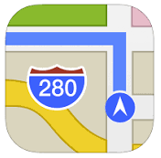

iPad — More apps (3 of 4)
WWF Free Rivers — AR Education
Start the app and follow the on-screen and narrated instructions. This app uses a simulation to teach about rivers and their importance.
Yelp — AR Overlay of Restaurants Nearby
Start the app and then tap on the Monocle icon at the bottom of the screen. Hold the iPad up facing the horizon and then spin around to see nearby restaurants labeled in AR. This app is meant to be used outdoors on a phone where it does a good job of putting the restaurant labels on their actual buildings.
Maps (Apple) — AR Map Flyover
Start the app, tap Sydney Opera House, then tap the Flyover Button. This will start a VR-like experience where you are hovering over Sydney. You can look around by moving the iPad and fly above the map by walking around. WATCH OUT for people and furniture if you start walking while looking at the screen.
Measure (Apple) — AR Measuring Tape
Start the app and follow the on-screen directions. This simple app lets you measure things and photograph them with the measurements overlaid.
Flip over this card for more apps

Slide 10



iPad — More apps (4 of 4)
iScape— AR Landscape Design
This is like the Ikea Place app, except that it’s for landscape design. You can try planting trees, shrubs, and flowers in our classroom or putting in a lawn.
Art — AR Preview of Prints and Photographs
This is a pretty conventional e-commerce app with a very central AR feature. Start the app and then scroll down and find a print or photo you’re interested in. Tap on it to bring up its page and then tap the “View in Room” button to see an AR preview of the piece hanging on one of the classroom walls.
Notable Women AR — Biographies of American Women
Point this app at a dollar or larger bill to see the portrait change to one of 100 historic American women. Discover the accomplishments of activists, artists, scientists, business leaders, writers, civic leaders and more. This app is a collaboration between Google and the former Secretary of the Treasury.

